Slide 1

Analyzing Twitter Data to Assess COVID-19 Ground Reality in India
Team 4
Poonam Ahuja
Smitha Kannanaikkal
Allen Lee
Stella Lee
Xueting Li

Slide 2
Twitter is one of the widely used channels of communication during pandemic
Use this mass information to try and understand the challenges and panic faced by the people
Objective

Slide 3




Dataset Details
Data Source: Kaggle
Duration:
January 2021 - March 2021
Data Origin:
India
Data Size:
250K tweets, 26 columns

Slide 4




Methodology
Data Cleaning
Exploratory Visualization
Topic Modelling
Sentiment Analysis

Slide 5
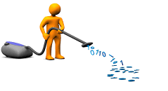
Data
Cleaning

Slide 6
Data Cleaning - Methodology
Lower case
Remove Hyperlink
Remove HTML tag e.g. %amp
Remove mentions
Remove stop words
Remove custom stop words
Remove punctuation
Emoji Contraction e.g. :-)
Text normalization
Text standardization eg. [pm modi, pm narendra, modi ji…..] -> modi

Slide 7
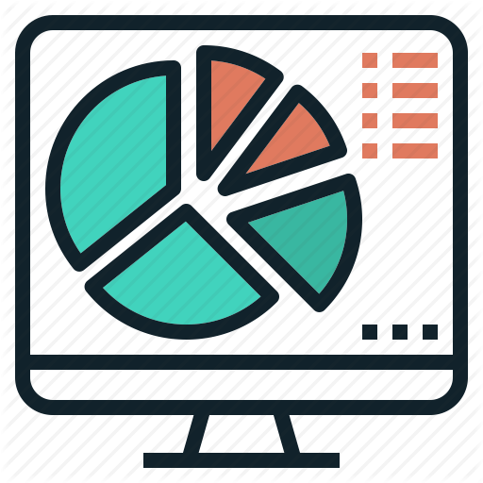
Exploratory
Visualization
Notes:
<a href="https://www.freepik.com/free-photos-vectors/background">Background vector created by freepik - www.freepik.com</a>

Slide 8
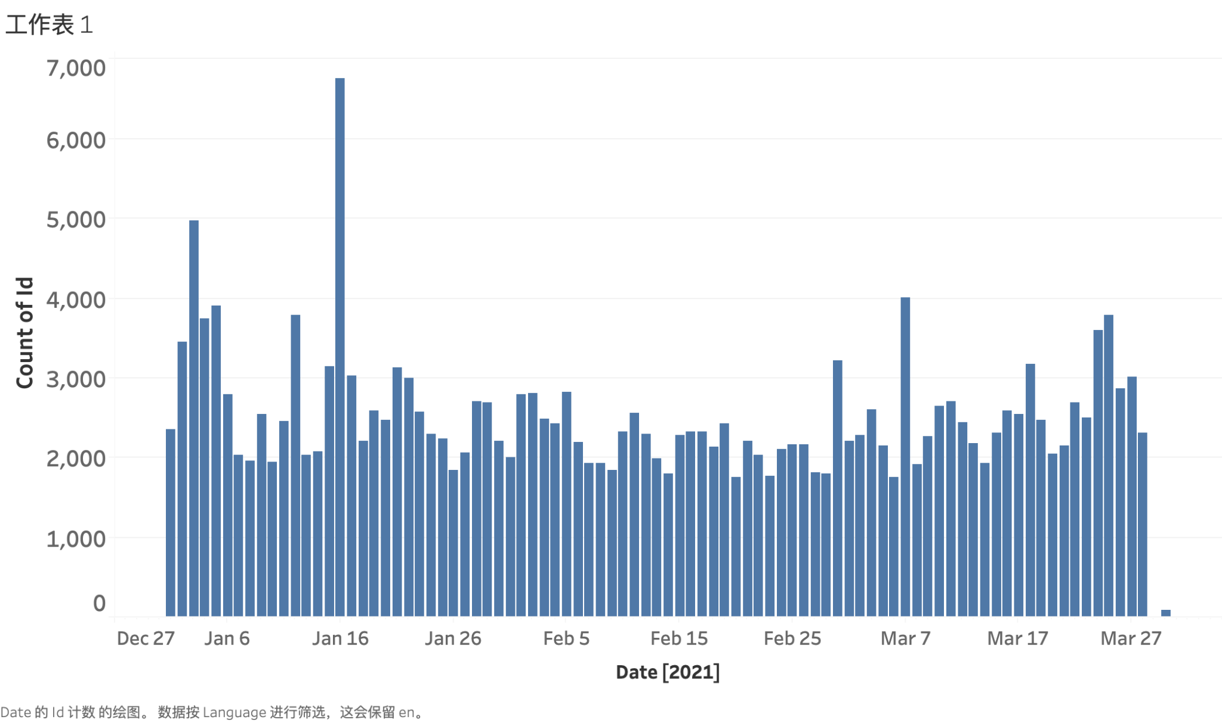
Number of Tweets Per Day

Slide 9
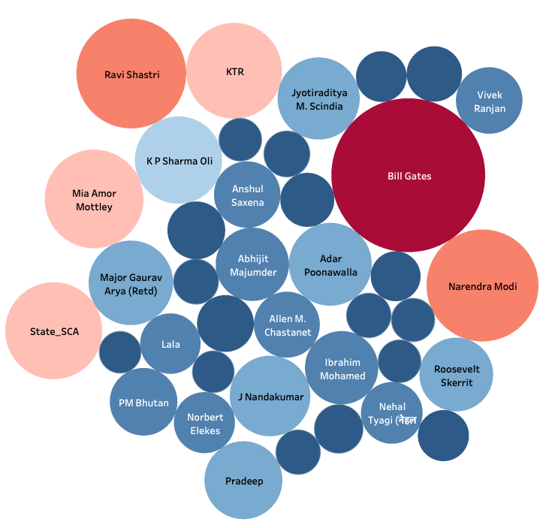
Users with most ‘likes’ count

Slide 10
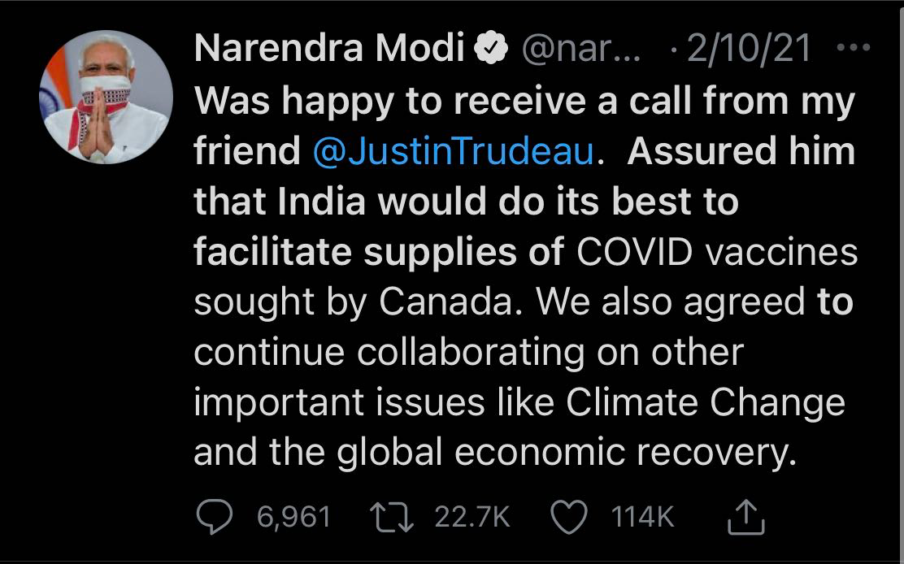
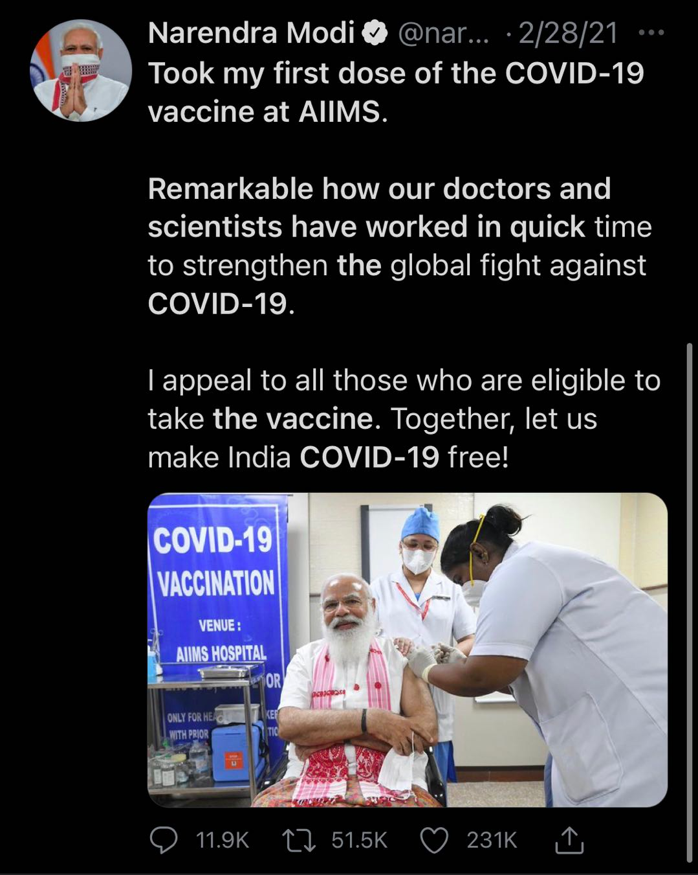
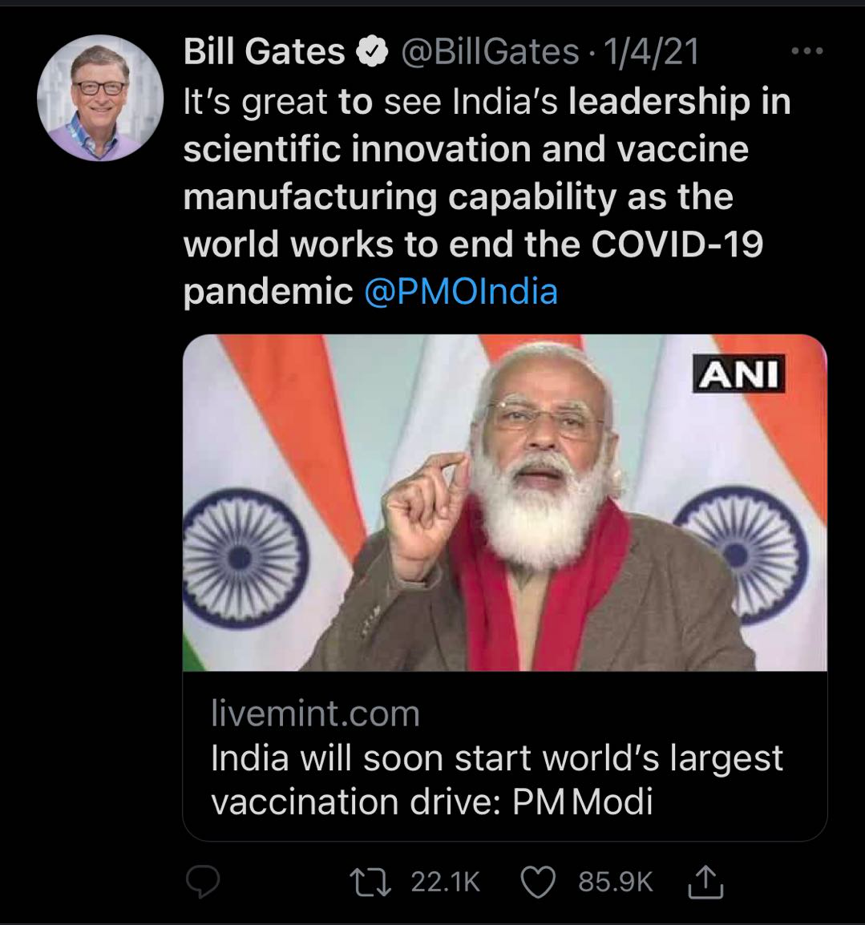
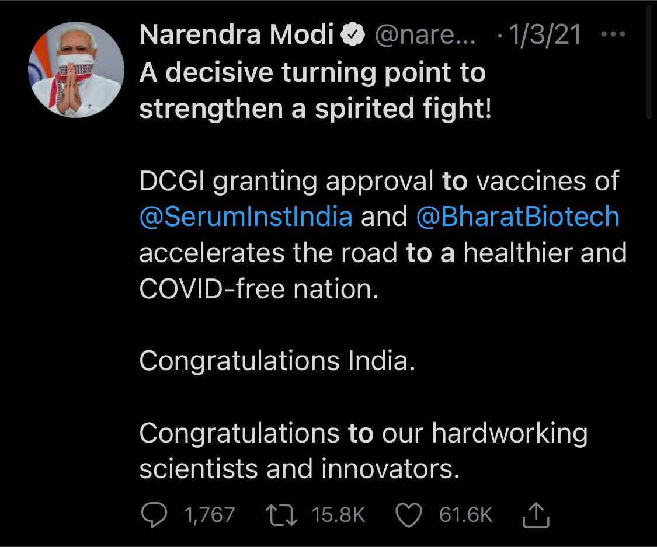
Top Retweeted Tweets

Slide 11

Topic Modeling
Notes:
<a href="https://www.freepik.com/free-photos-vectors/background">Background vector created by freepik - www.freepik.com</a>

Slide 12
Extracted Topics
vaccination approval
astrazeneca
biotech
covishield
drive
Vectorization Technique:
Bag of Words
Vaccine
new
death
strain
virus
report
test
gst
tax
expert
year
due
app
COVID cases & death
Finance/Income/Money

Slide 13
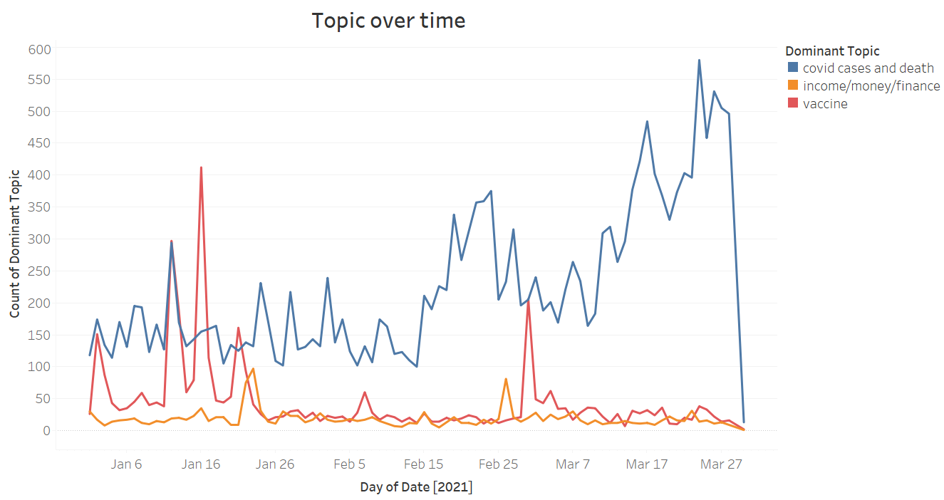
Second Wave

Slide 14


Slide 15

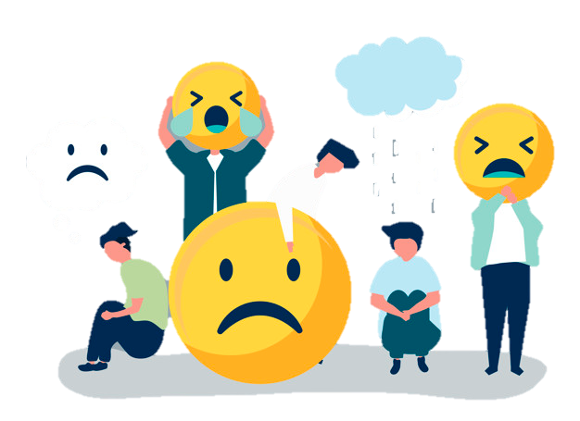
Sentiment
Analysis

Slide 16
Sentiment Analysis Procedure
Additional Text Cleaning
Data Preparation
Sentiment Analysis
Previous Cleaning
Emotion Contraction
ex) :-) → Smiley
: < → Sad
Deal with Emojis
ex) 👍 → Thumbs Up
🔥 → Fire
All Tweets
Tweets that mention ‘Modi’
Top Sentiment Words of Tweets
Sentiment Across Time
Remove Words not conveying the true sentiment

Slide 17
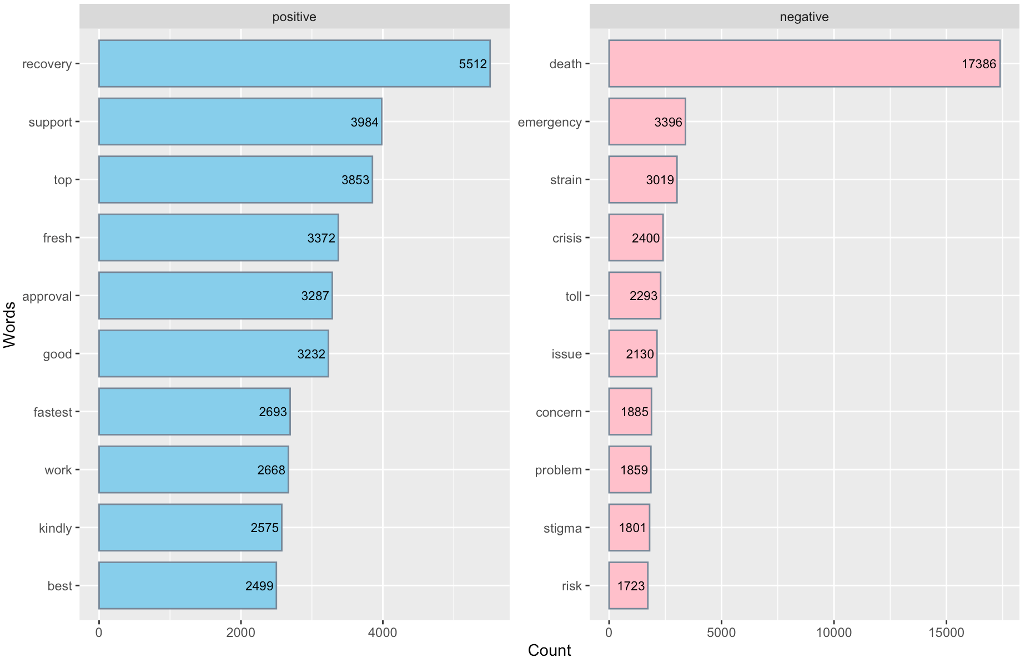
Positive/Negative Words of Entire Tweets
Removed words like “positive” ,“negative”, “virus”, “outbreak”, etc.
The word, “Death” appeared overwhelmingly in comparison to both positive and negative frequent words

Slide 18
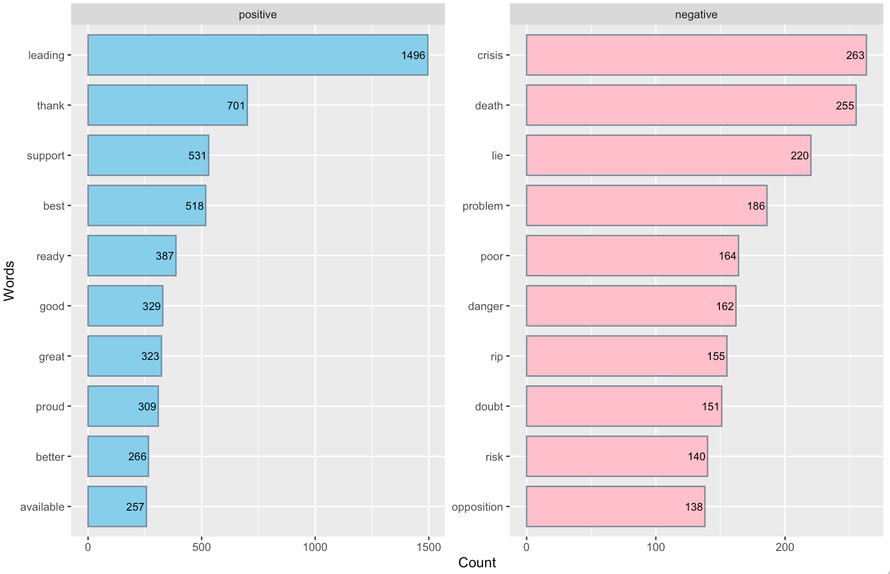
Positive/Negative Words mentioning “Modi”
For positive sentiment, there are words like, “support”, “best”, “proud”.
For negative sentiment, there are some words like, “lie”, “poor”, “doubt”.
The number of positive words far exceeds the number of negative words
People are generally more positive when they mention about ‘Modi’

Slide 19
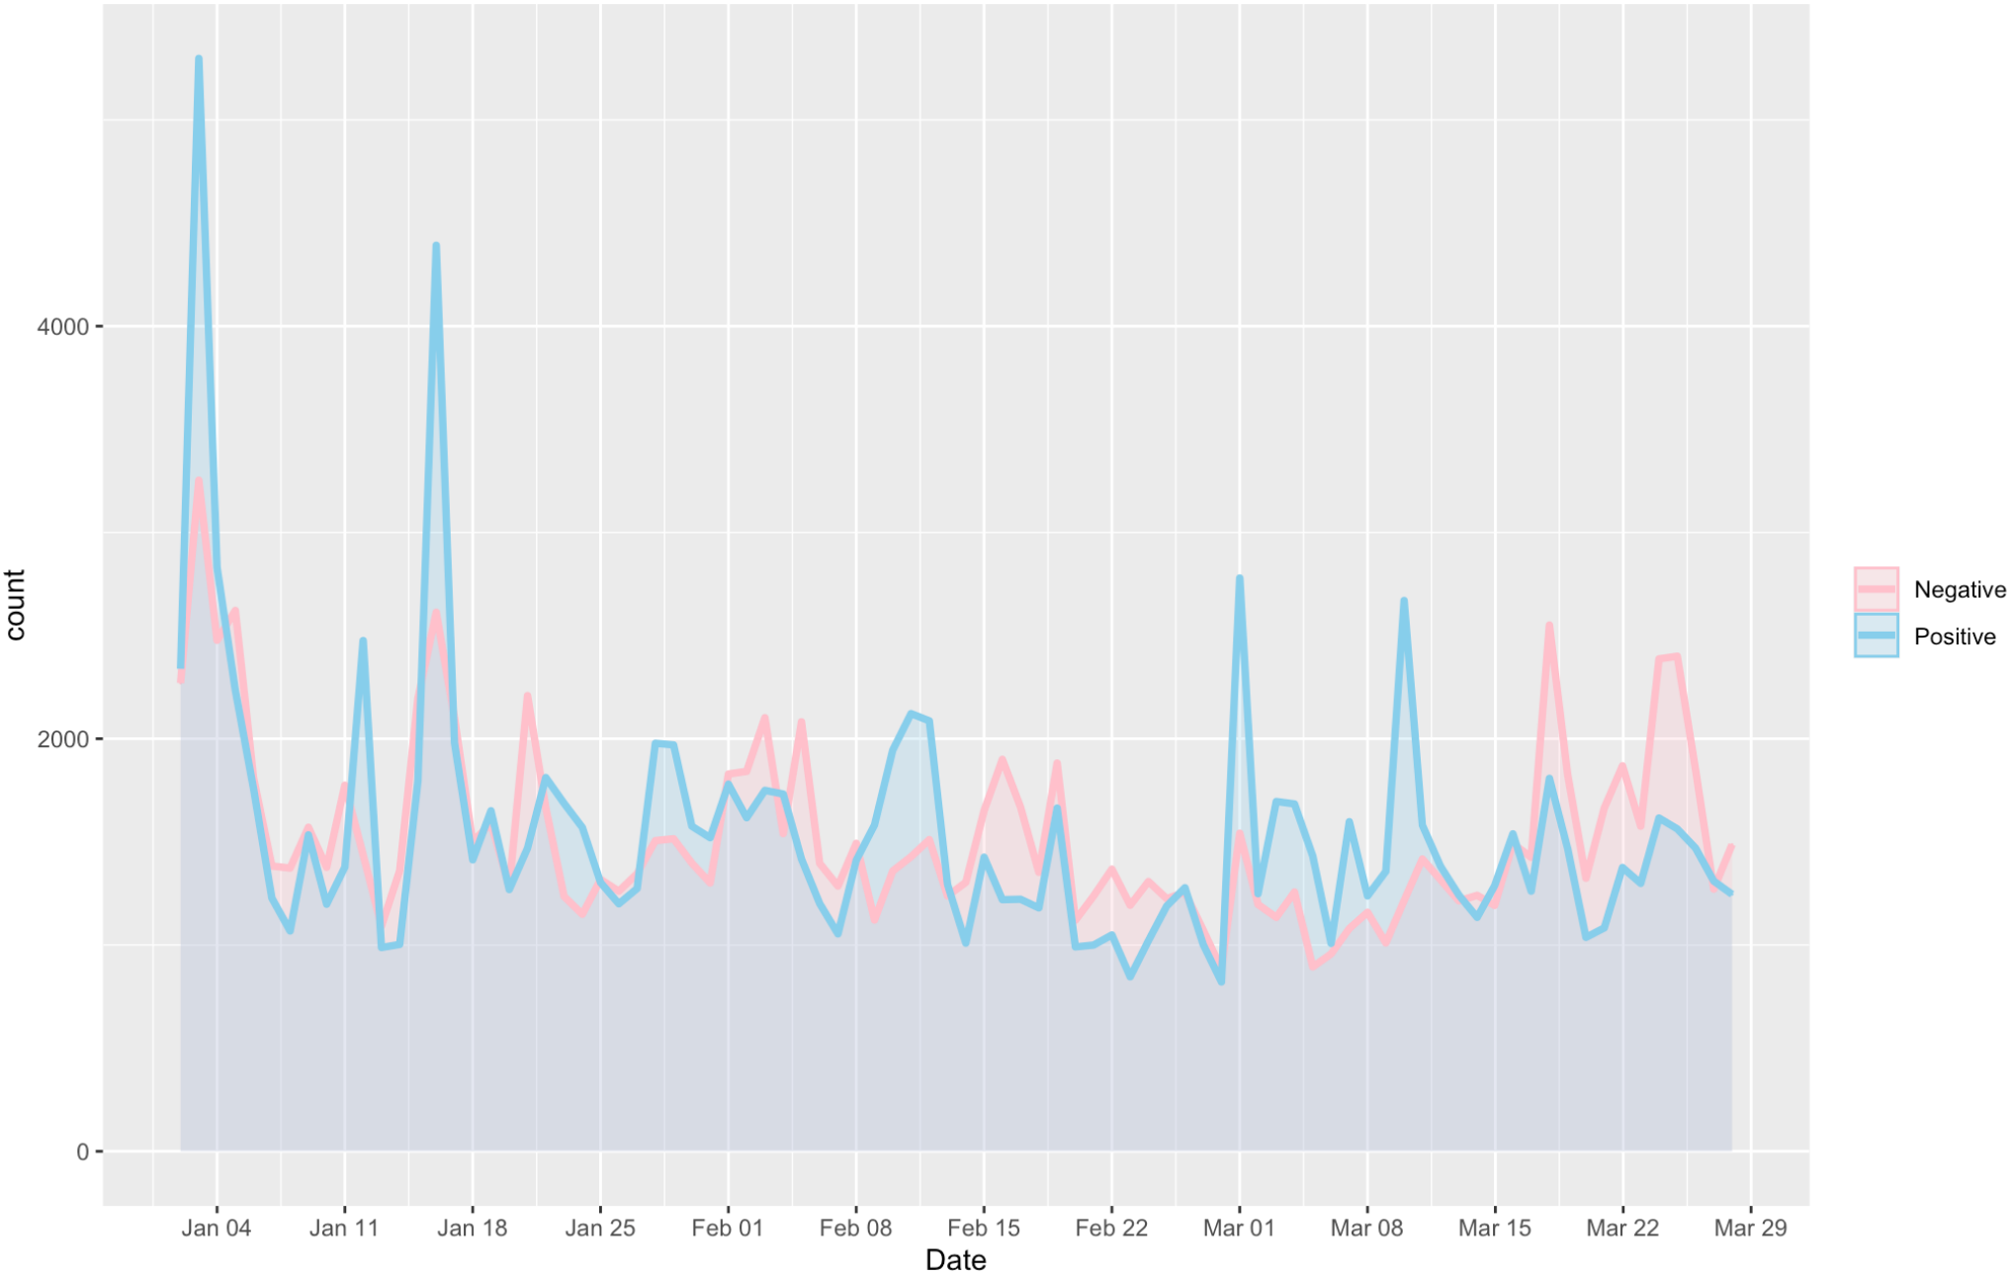
Sentiment Across Time for Entire Tweets
Removed more words like “trump”, “shot”, “patient”, etc.
Beginning of March we see positive sentiment spikes.
Towards March end we see Negative sentiment dominating positive.

Slide 20
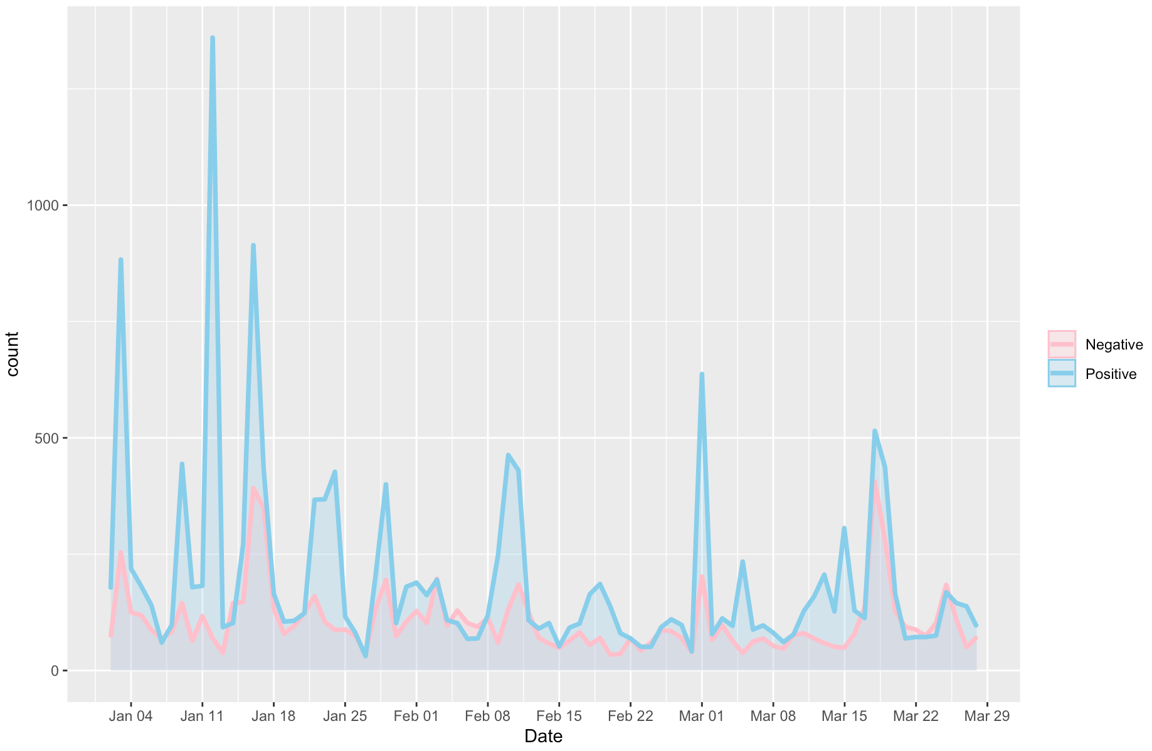
Sentiment Across Time mentioning “Modi”
Overall sentiment for tweets that mentions “Modi” are positive over time.
January
Approval, Proud, Support
March
Danger, Doubt, Lie

Slide 21
Challenges/Limitations
The time span of the dataset was too short.
The data consists many typos, jargons, and symbols which hinder us from analyzing sentiment.
Key Takeaways
While performing lexicon based sentiment analysis, we need to be cautious about the words included in the analysis.
NLP techniques like topic modeling and sentiment analysis, allows to uncover the insights and trends.
Government and Health community could use our analysis to further strategize for better handling of COVID-19 sentiments in India.

Slide 22

THANK YOU

